Slide 1

Semi-Automated Welding Machine using Adaptive Control and Prediction Analysis using Machine Learning
Project Work
B.Tech-Mechanical Engineering
Rushti Rajoli T
R. Danush Raghavan
M. Gowshik
J.R. Aravind
RA1811002020085 RA1811002020075 RA1811002020078
RA1811002020110
Batch no: 33
Under the Guidance of
Mr. K. Vinothkumar, ME,.
Assistant professor (Sr.G)
Department of Mechanical Engineering
SRM INSTITUTE OF SCIENCE AND TECHNOLOGY
Ramapuram,Chennai-600089

Slide 2

Objective of the Project
The objective of the project is to build a Semi Automated Welding Machine to overcome the difficulty facing by Small Scale Industries such as accuracy of welding in large number of jobs, skilled labour, welding quality. This project will eventually reduce the human work. This machine can be used for welding in small scale industries to reduce the skilled labour cost, to increase the accuracy of welding, to completely reduce the hazardous accidents such as burns, eye damage, electrical shock, cuts and injury to toes and fingers. This semi-automated welding machine is affordable compare to fully automated welding machine so it is economical for Small Scale Industries.
Slide 2

Slide 3

Abstract
Quantity monitoring is an important task for controlling and correcting factors that are necessary for a proper weld. The major factors which affect the welding process are temperature, current and voltage, velocity, wind speed, and gas flow rate. They play a vital role hence monitoring of these factors is very essential. In this work, monitoring the data is done by sensors and the Arduino microcontroller. The consumption of welding electrodes, temperature, gas flow rate, velocity, current, and voltage is measured by the respective sensors during the process itself. This semi-automated welding machine is affordable compared to fully automated welding machines so it is economical for Small Scale Industries and can reduce human error.
The prediction analysis for the obtained data set will be done using Multi-linear Regression.
Slide 3

Slide 4

Introduction
Semi-automation is a process or procedure that is performed by the combined activities of man and machine with both human and machine steps typically orchestrated by a centralized computer controller. Many manufacturers choose not to fully automate a process due to the complexity of the task, or the low number of products produced. Other processes may not be fully automated because it may reduce the flexibility to easily adapt the processes to reflect production needs.
Prediction Analysis can be done using Multi-Linear Regression from the obtained data set values.
Slide 4

Slide 5


[1]ShendageYogesh, etal. The paper conveyed the D‐optimal method is relatively a new technique, related to response surface methodology, used for carrying out the design of experiments, the analysis of variance, and the empirical modeling..
[2]MOHD KHAIRULAMZARI BIN HAMJAH,etal. The paper conveyedthe selection of the parameters is a key factor in producing the optimal surface roughness of weld bead. Surface roughness plays a very important factor in mould industries. By improving the surface roughness, extra work or finishing can be avoided and it can reduce time and manpower constraint in producing mould.
[3]SanidhSanchala, etal. The paper conveyed in the welding process the number of parameters affected the quality of weld. In case of linear and angular welding, angular welding is much more difficult than linear welding. In order to get the desire quality of weld one has to give accurate feed, which is one of the most important parameter. Due to the automation using VFD the weld accuracy and quality is increase with controllable linear motion of Welding torch with precise feed of work with less time utilization.

Slide 6


Literature Review
[4]Vaishnav Karan,etal. The paper conveyedthe study suggests that the number of parameters affected the worth of weld. In case of linear and angular welding, angular welding is much more problematic than linear welding. In order to get the get quality of weld one has to give precise feed, which is one of the most significant factor.
[5]Akshay M, etal. The paper conveyed they have developed “A SEMI-AUTOMATED ARC WELDING MACHINE” which is very useful in small industries and provides safety for the worker. Maximum thickness of work piece (mild steel) the machine can weld is less than 6mm. The maximum length up to which the machine can weld is 150mm and maximum width of the metal piece to be weld is up to 50mm.
[6]AshwaneKumar Srivastava, etal. The paper conveyedthey have developed a fully automated welding which is using in medium and large scale industries. It consists of Drive, Controller, Multi axis robot which is programmed using Teach Pendant after the installation. It is a very high cost automation which the micro and small scale industries could not afford it.
[7]Seayon S. Dmello, etal. The paper conveyedas we seen in the above Literature. They have developed a fully automated 2-axis welding chine which is using in medium and large scale industries.

Slide 7



Literature Review
[8]Faiz F. Mustafa, etal. The paper conveyedmachine that hold and carry the welding gun of the MIG machine moving on a circular rail fixed near the pipe groove, can helpfully to improve the welding finish compared with the manual process by maintaining in parameters of welding such as keep the distance between the gun and the groove of weld joint, constant travel speed of the welding gun, also saving in time and funds.
[9]Monika, etal. Welding joins two materials. It beats both casting and riveting in terms of speed and cost. There are several things that use welding such as ships, rail road equipment, launch vehicles and boilers. Among the available welding methods are TIG (tungsten inert gas), MIG (metal inert gas), SMAW (shielded metal arc welding), PAW (plasma arc welding), FCAW (flux core arc welding), SAW (submerged arc welding), GMAW (gas metal arc welding), ESW (electro slag welding), and OA (oxyacetylene) welding.
[10]Eyob Messele Sefene, etal. Before Friction Stir Welding, mechanical fasteners were used to join aluminium and its alloys in aeroplane structural elements. For example, the Eclipse Aviation industry employed 7,300 rivets every Eclipse 500 business class aeroplane (fuselage). The Welding Institute (TWI) of Cambridge, UK, created Friction Stir Welding in 1991 [1, 2]. FSW is a solid-state welding technology commonly used to combine non-ferrous materials like aluminium, magnesium, and copper structures where high strength to lightweight welds are required

Slide 8
Problem Statement
During hand welding, problems such as undercut, lack of fusion, insufficient penetration, fractures, insufficient surface finishing, not having a fair feed, and so on might occur. The abovementioned welding faults can be reduced with the help of automation. This project helps to increase the efficiency of automation by integrating with Artificial Intelligence (AI), which helps in controlling input parameter.
Welding Current and Torch angle
Welding Speed and Trajectory
Weld Bead Geometry
Electrode Positioning
Weld Pool

Slide 9


Proposed Work
Fabrication of the entire semi-automated welding system.
Further process includes analysis of the weld quality using various test such as
Vickers Hardness Test
Microscopic structure and Macroscopic Structure
The derived output data from these tests was predicted using machine learning techniques such as Regression which comes under Supervised Learning.
Algorithm – Multi-Linear Regression

Slide 10



Work Schedule
Week | Work Schedule
1 | Literature Review for Problem Identification
2 | Literature Review for Material Identification
3 | Literature Review for selection of Testing
4 | Problem Identification
5 | Problem Methodology and Solution
6 | Parameter Selection
7 | Material Selection
8 | Material Purchase
9 | Fabrication of welded joints
10 | Testing
11 | Implementing Artificial Intelligence
Slide

Slide 11
Fabrication
S.No | Components | Qty
1 | Arduino Controller | 1
2 | Servo motors | 2
3 | Stepper Motor | 1
4 | Lead Screw | 1
5 | Guide Ways | 2
6 | Driver | 1
7 | Fixture Table | 1
Arduino is an open source, computer hardware and Software Company, project, and user community that designs and manufactures microcontroller kits for building digital devices and interactive objects that can sense and control objects in the physical world. Arduino board designs use a variety of microprocessors and controllers.
Stepper motors are DC motors that move in discrete steps. They have multiple coils that are organized in groups called "phases". By energizing each phase in sequence, the motor will rotate, one step at a time. With a computer controlled stepping you can achieve very precise positioning and/or speed control.
Lead screws are a very popular way to convert motor rotation into linear translation. They can offer fair axial stiffness and very good, smooth small displacements. Lead screws are generally preloaded with an axial load that helps to maintain a permanent contact between the nut and screw filets. This minimizes hysteresis but also generates some heat in the contact area due to friction.
Slide 12

Slide 12
Fabrication
GUIDE WAYS
The Guide way is an essential component of machine tools. The primary role of the guide way is to ensure that the cutting tool or operating element of the machine tool follows a specified route. The operating component of the machine tool transports the work piece.
MOTOR DRIVER
Built on the Toshiba TB6600HG IC, the TB6600 micro stepping driver may be used to power two-phase bipolar stepper motors. With a maximum continuous current of 3.5 A, the TB6600 driver may be utilised to handle very large stepper motors such as a NEMA 23. Ensure that you do not connect stepper motors with a current rating more than 3.5 A to the driver. Multiple safety features, including overcurrent, under voltage shutdown, and overheating protection, are included into the driver. That the actual specs and measurements may vary significantly across manufacturers.

Slide 13
Fabrication
SERVO MOTORS
A servomotor is a closed-loop servomechanism that regulates its motion and final position using position feedback. The command position for the output shaft is represented by an analogue or digital signal supplied to the control. A position encoder is linked to the motor in order to provide position and speed feedback. In the most fundamental instance, just the position is measured. The measured output position is compared to the command position, which is the external input of the controller.
FIXTURE TABLE
Different kinds of materials are used to make the Jig and its parts. There are times when metals are made harder to make them less likely to wear down. Sometimes they are made of nylon or fibre to protect the work pieces. The paper gave a detailed explanation of what jigs and fixtures are and listed the many benefits of using them in manufacturing. The calculated values showed that a 16-millimeter-diameter mould will lead to the construction of rigid and strong jigs and fixtures that will ensure high machining accuracy, consistent product quality, and interchangeability.

Slide 14
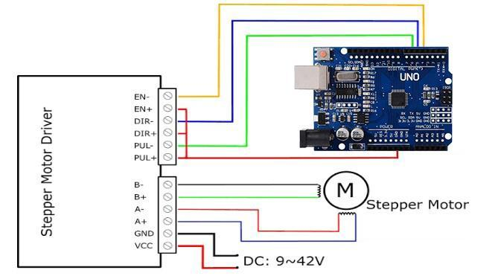
Fabrication
Automation
Automation is done by using the Arduino Controller, TB 6600 Driver and Stepper Motor using Arduino Software.
Source Code
#include <AccelStepper.h>
#include <Servo.h>
Servo Voltage_servo;
Servo Speed_servo;
……………….
Serial.println(" 'I' : Sets a voltage value For Knob.. From 0-180.I80");
Serial.println(" 'T' : Sets a Torch value ON/OFF is 30/0.T30");
Circuit Diagram

Slide 15

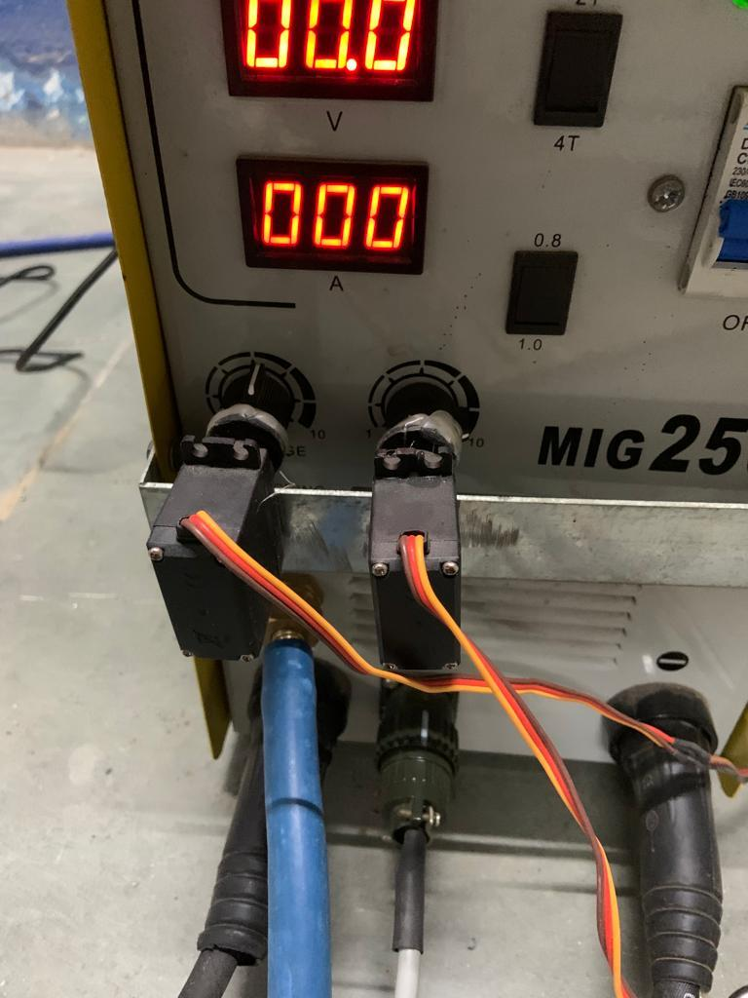
Parameters
CURRENT (A) | VOLTAGE (V) | SHIELDING GAS
200 | 30 | 20
210 | 30 | 20
238 | 35 | 20
250 | 30 | 20
Voltage and current are controlled using a servo motor wherein motor angle of rotation determines the adjustment of respective parameters
Code Chunk:
D - Feed speed/Current (0 to 180)
I - Voltage (0 to 180)
Volt & Current Control Servo motor

Slide 16
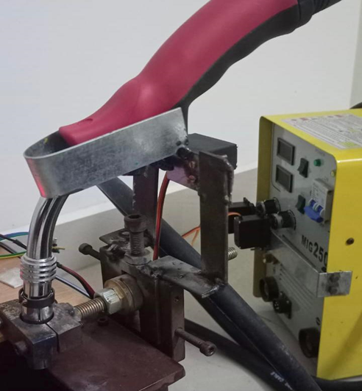
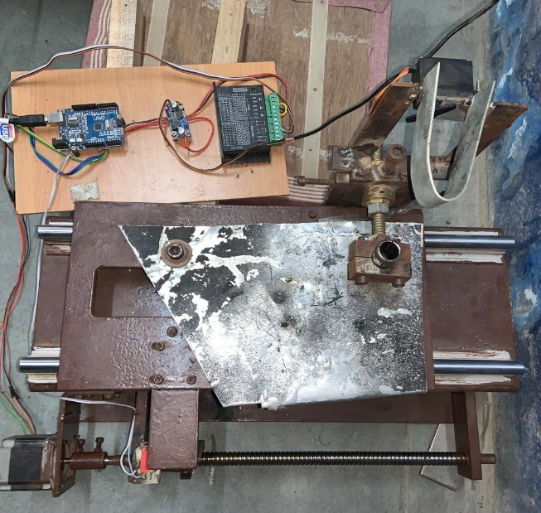
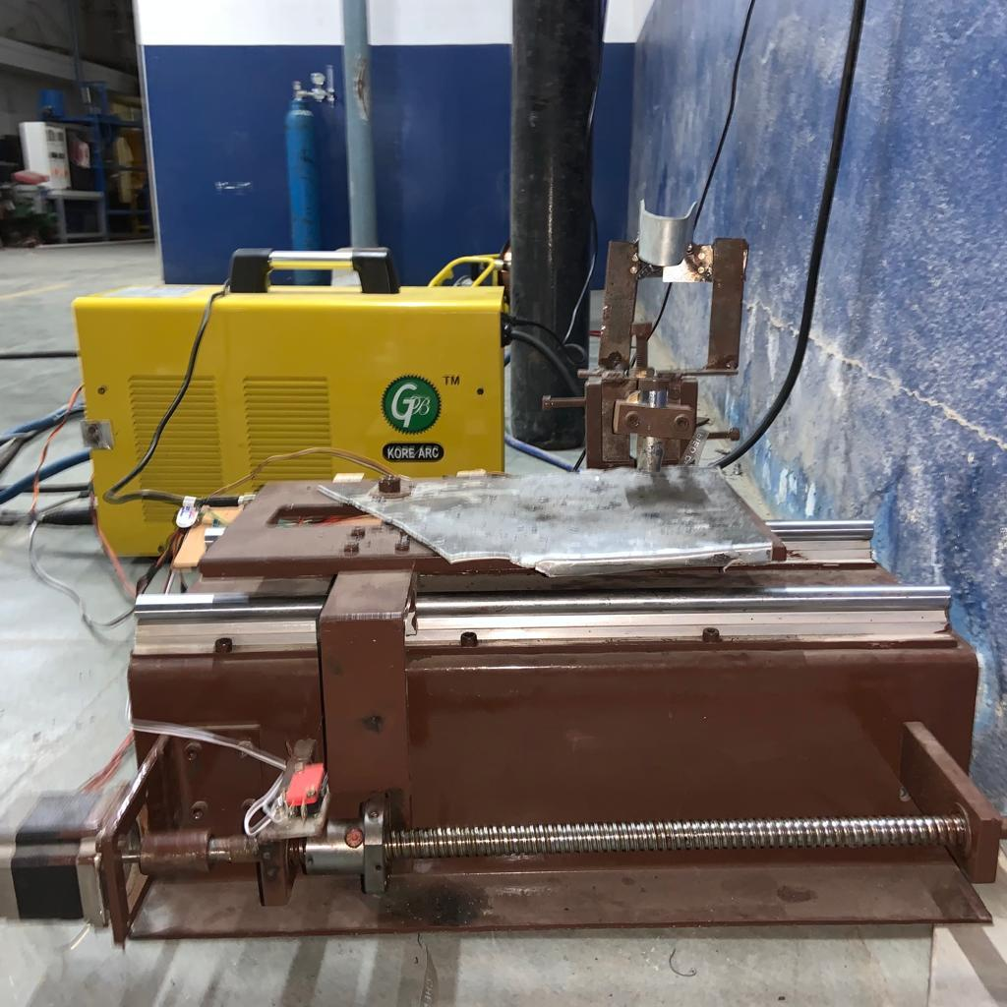
Parameters
Torch angle and position:
Torch position is fixed and angle is changed according to the metal position. The switch is controlled using Arduino UNO.
Code Chunk:
T0 ‘ON’
T30‘OFF’
Torch angle and position
Fixture Table:
Base Table is controlled using a Stepper motor that has three-speed level
of 400 RPM, 800 RPM, and 1600 RPM with travel distance of about 30 cm which are controlled by position points that is from 0 to 60000 where 1cm is equal to 2000 position points
Fixture Table

Slide 17
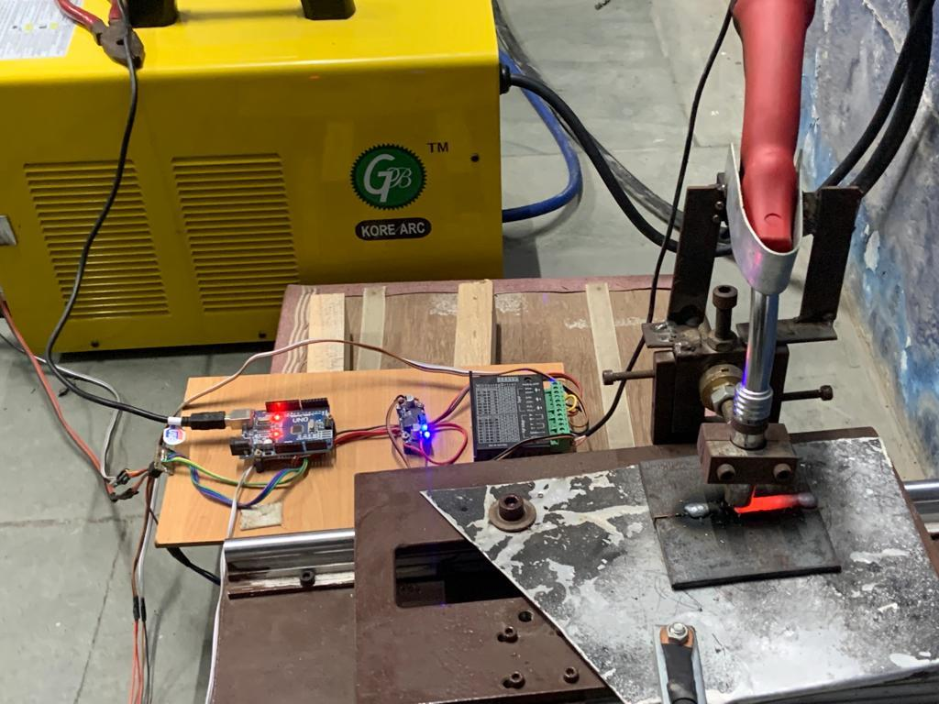
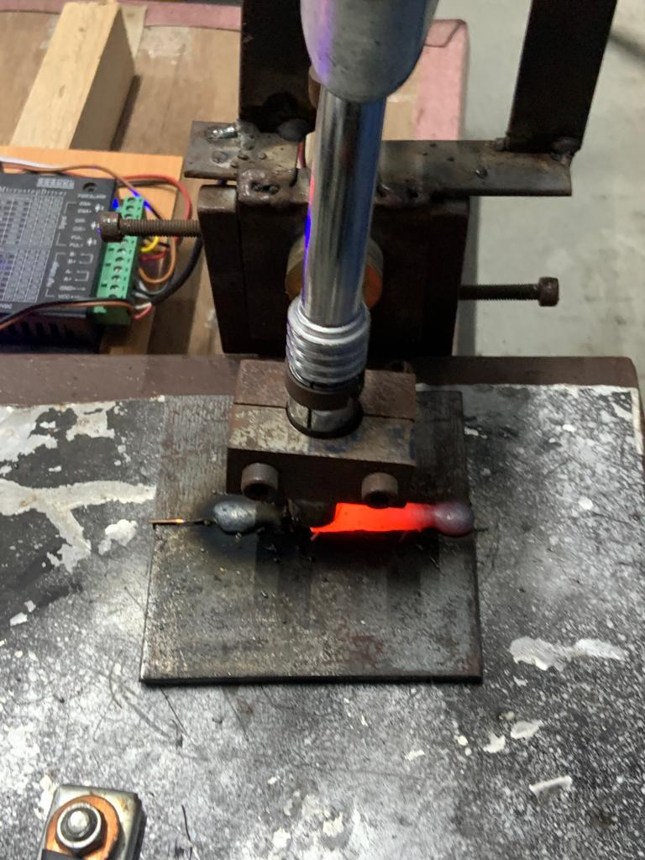
Parameters
Weld Process:
Once the values have been entered the base plate moves to the required position and simultaneously the torch will ON and the welding process will be carried out according to the entered parameters
weld pool

Slide 18

Testing
The following tests were carried out after welding:
Vickers Hardness Testing
Metallurgical Microscopic & Macroscopic Test
Vickers Hardness Testing Results:
Vickers hardness tester with a 1kg load and a 10s dwell time was used to measure the hardness of the base metal, the Heat Affected Zone, and the welds
TEST REPORT
Hardness Analysis:
 | Hardness Values, Hardness Vickers @ 0.5 Kgf; Dwell : 10Sec
sample I.D | Zone-1 Parent | Zone-2 HAZ | Zone-3 Weld
1 | 211.6 | 208.4 | 212.8
2 | 172.0 | 191.1 | 203.6
3 | 211.8 | 204.1 | 169.1
4 | 180.4 | 208.8 | 158.6

Slide 19
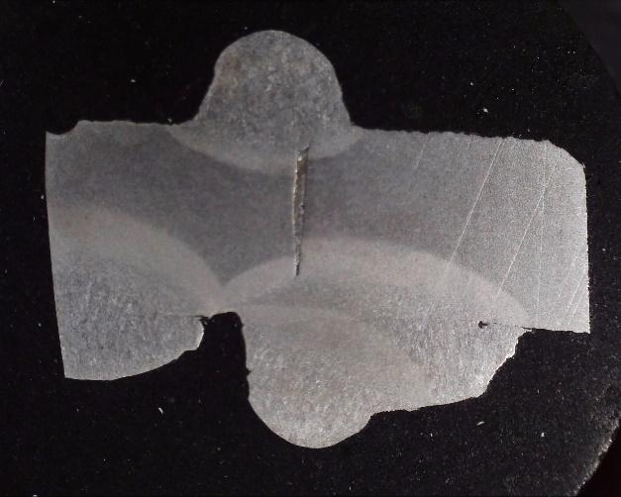
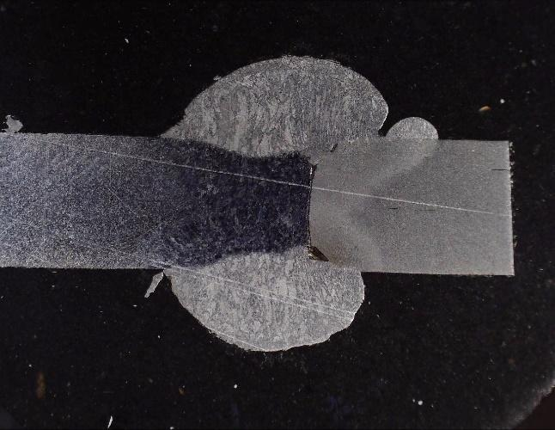
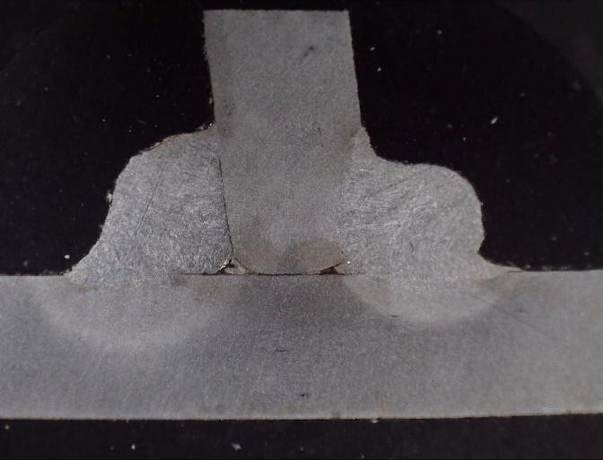
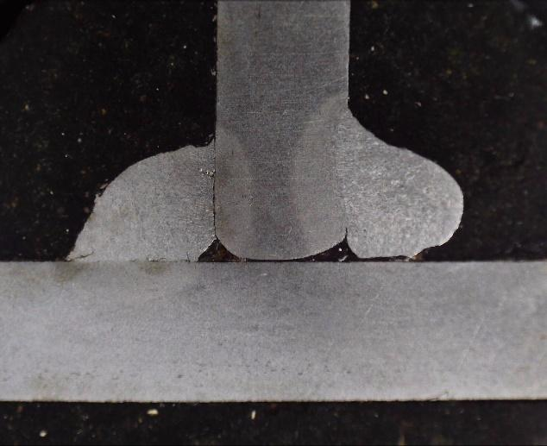
Testing
Macroscopic view of weld :
Butt-Joint :
T-Joint :
Automated Manual Automated Manual

Slide 20
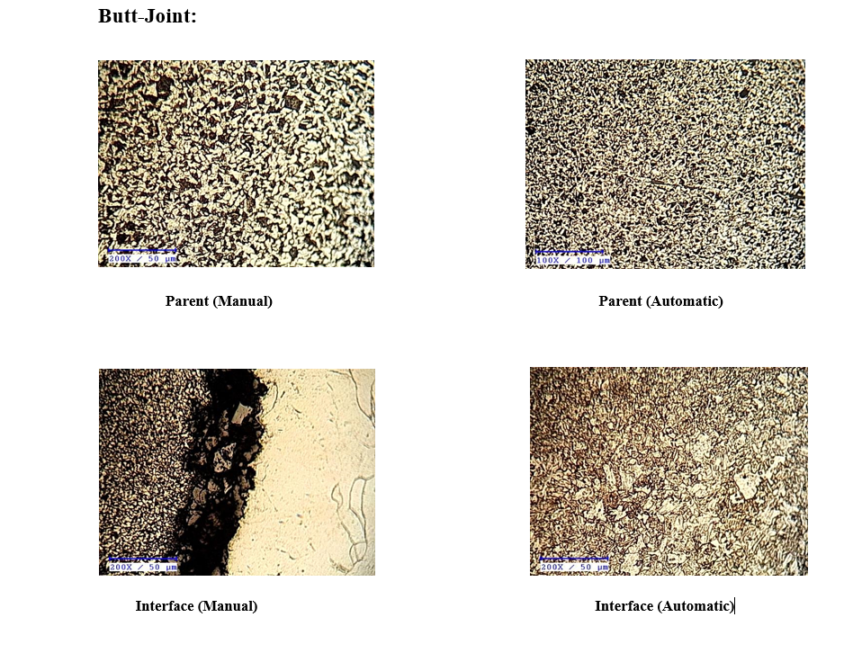
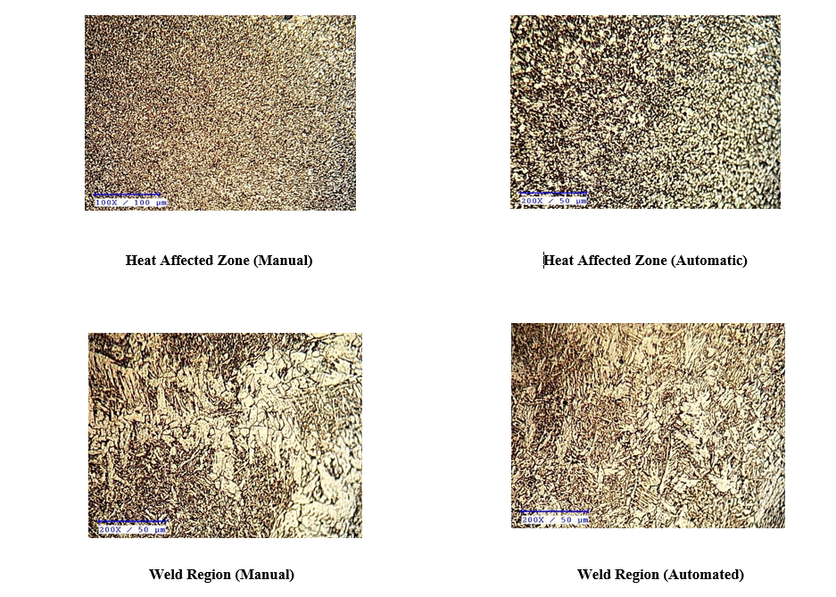
Testing
Metallurgical Microscopic Test Results
Photographic portions of the samples were collected once the microscopic analysis was completed. The microstructure of the base metal, Heat Affected Zone (HAZ) of base metal, and welded area of the four samples were investigated. Microstructure of weldment areas corresponding to different process parameters were thoroughly studied to determine the existence of hot cracking. Welded joints exhibit a high degree of microstructure heterogeneity. Weldment cross-section profiles and microstructure at various weld zones of Gas Metal Arc Welding Mild Steel 30L are shown

Slide 21
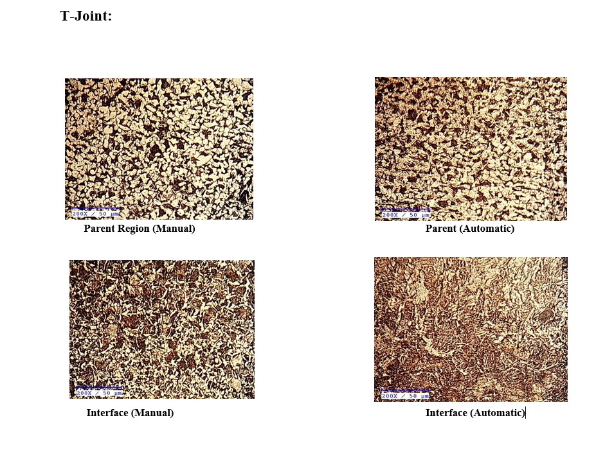
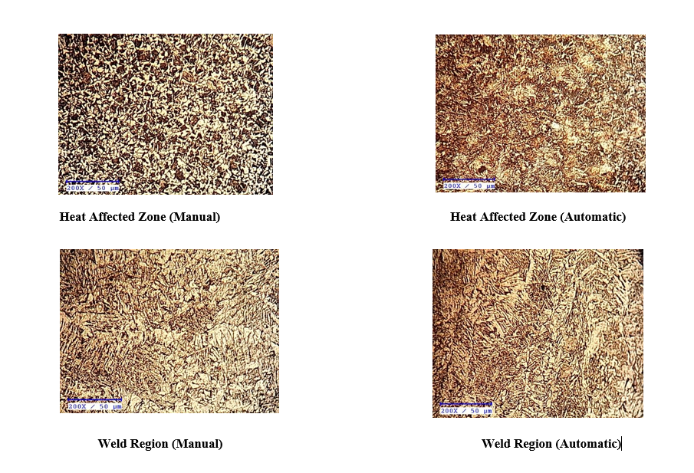
Testing

Slide 22
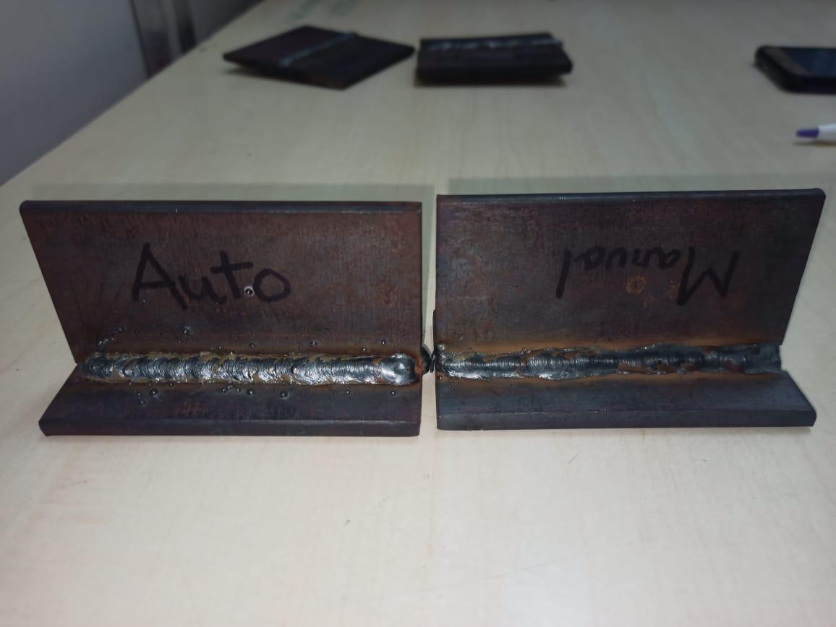
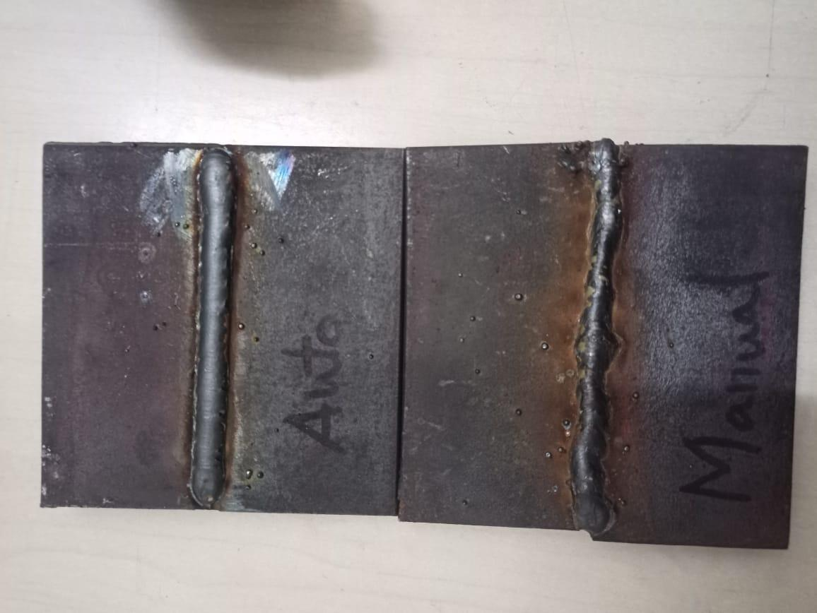
Results And Discussion
The welded work piece using a Semi-automated Welding Machine and the Hardness and Microscopic Structure was done. A comparison between a Manually welded work piece and a Semi-automated welded work piece was conducted.
T Joint and Butt Joint

Slide 23
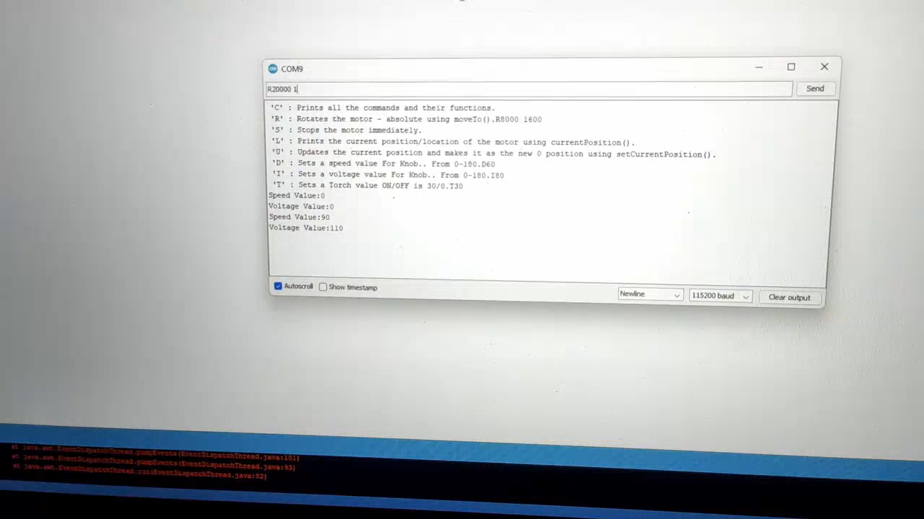
Working Video

Slide 24
Results And Discussion
Implementation of Machine Learning Algorithms:
Software Used - Jupyter Notebook
Libraries used:
Pandas
Numpy
Matplotlib
Seaborn
Scikit-Learn

Slide 25
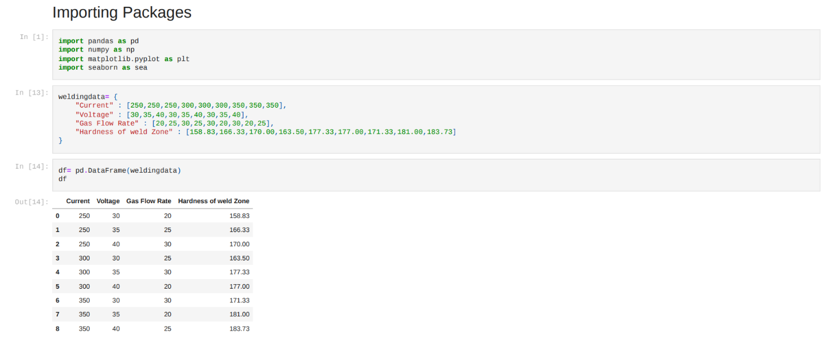
Results And Discussion

Slide 26
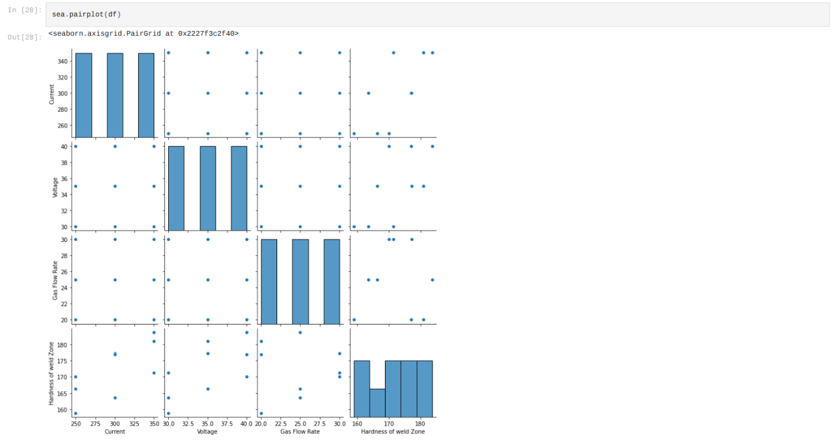
Results And Discussion

Slide 27
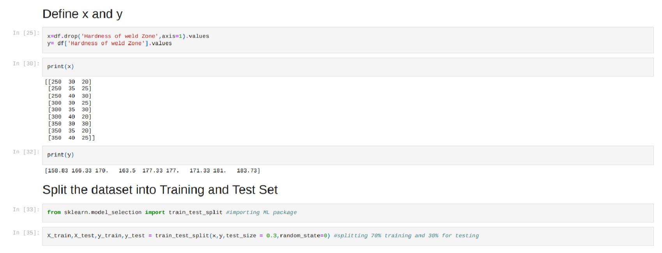
Results And Discussion

Slide 28
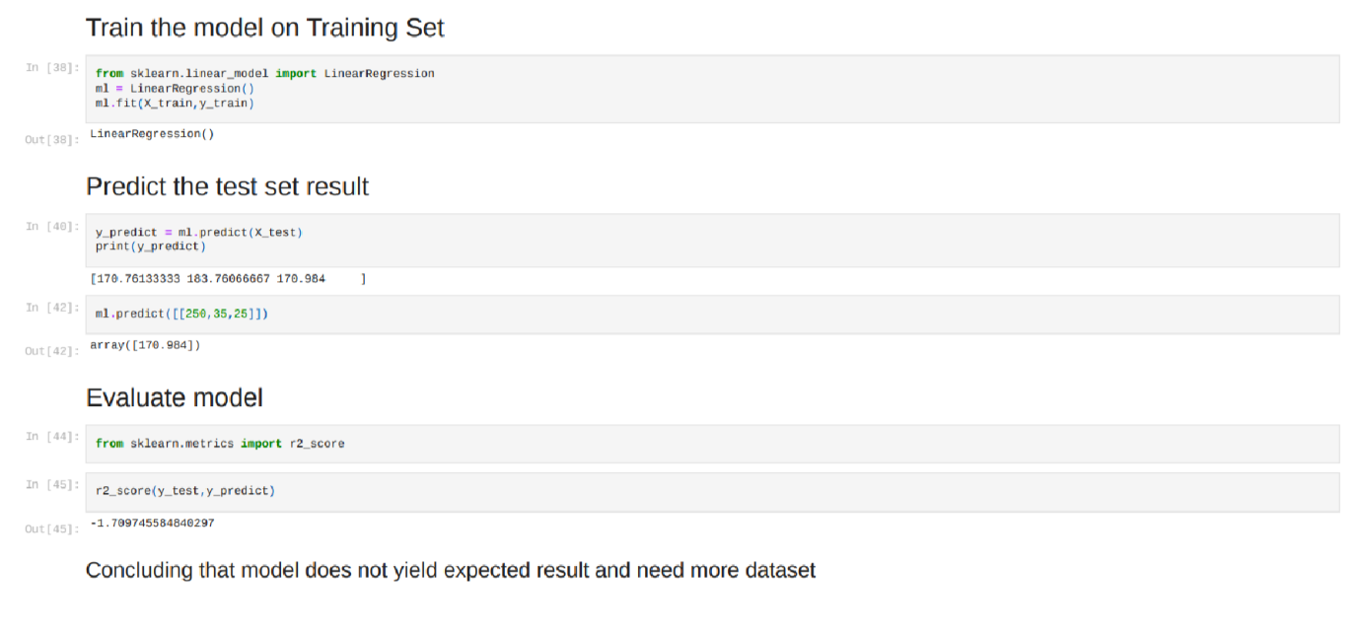
Results And Discussion
Multi-Linear Regression algorithm was used to predict the Heat affected zone (HAZ).

Slide 29


Conclusion
The manual welding process has lot many limitations and disadvantages like less productivity, inconsistence quality of welding and dimensional inaccuracy, and dependency on operators to large extent. All these disadvantages are overcome by Semi-Automatic Welding Machine. Semi-automated welding machine takes less time to weld when compared to unskilled labour. Adopting a semi-automatic welding machine is better than opting for unskilled labour for welding. The prediction of HAZ using multi-linear regression failed to yield results as the data required was insufficient.
Slide 28

Slide 30

References
[1]ShendageYogesh, etal. The paper conveyed the D‐optimal method is relatively a new technique, related to response surface methodology, used for carrying out the design of experiments, the analysis of variance, and the empirical modeling.
[2]MOHD KHAIRULAMZARI BIN HAMJAH,etal. The paper conveyedthe selection of the parameters is a key factor in producing the optimal surface roughness of weld bead.
[3]SanidhSanchala, etal. The paper conveyed in the welding process the number of parameters affected the quality of weld.
[4]Vaishnav Karan,etal. The paper conveyedthe study suggests that the number of parameters affected the worth of weld. In case of linear and angular welding, angular welding is much more problematic than linear welding.
[5]Akshay M, etal. The paper conveyed they have developed “A SEMI-AUTOMATED ARC WELDING MACHINE” which is very useful in small industries and provides safety for the worker. Maximum thickness of work piece (mild steel) the machine can weld is less than 6mm.
[6]AshwaneKumar Srivastava, etal. The paper conveyedthey have developed a fully automated welding which is using in medium and large scale industries.
[7]Seayon S. Dmello, etal. The paper conveyedas we seen in the above Literature. They have developed a fully automated 2-axis welding chine which is using in medium and large scale industries.

